Slide 1

Green Living Areas platform on policies!
MED Talks 3rd Edition
16th of December 2025

Slide 2



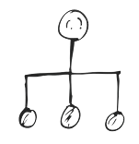
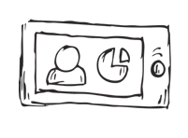
The process in brief
Identify
Evaluate
Policy Instruments
Policy recommendations
Connect
Implement
Disseminate
Policy Dialogues to Adapt, Replicate, and Upscale public policy instruments
Gained knowledge and expand the network
A sustainable collaborative space set up to implement exchanges on policy instruments referring to Green Living Areas.

Slide 3

Institutional Policy Dialogue Path
1
A collaborative process to
Exchange,
Adapt,
Replicate,
Transfer
successful policies!
2
Identification of Policy Instruments
Evaluation of Instruments
3
4
Working Groups of Solution Providers
5
Expert & Policy Maker Group (Core)
Windows & Match with Potential Takers
6
Dialogue Implementation
7
Dissemination & Uptake
8
Policy Papers & Recommendations
Notes:
Institutional Dialogue: A loop process of exchanges on policy instruments to adapt, replicate and transfer relevant ones

Slide 4
Steps for Evidence-Based Policy Making
Identification of Policy Instruments
Evaluation (multi-criteria)
Work with Solution Providers/Technical actors
Discuss feasibility & policy adaptation
Expert & Policy Maker Group
Concrete, time-sensitive opportunities
Identify Policy Windows (potential takers and opportunities)
to adopt, scale, integrate, or improve public policies
Dialogue Implementation
Co-develop and refine proposals, i.e., policy papers & recommendations
Validate with stakeholders and experts.
Disseminate & Uptake (share through Policy Hubs, Networks, EU events).

Slide 5

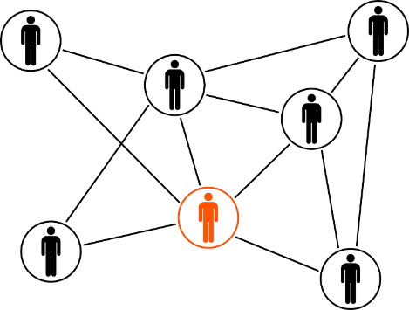

EUCLID Policy Hub Platform
A sustainable collaborative space set up to implement exchanges on policy instruments referring to Green Living Areas.
Objective of the dialogues
Promote policy-oriented results and answer the needs of the Thematic Projects,
Engage policy-oriented partners and associated partners,
Establish a Core Group to Advise on Maximizing the Impact of Policy Outputs.

Slide 6
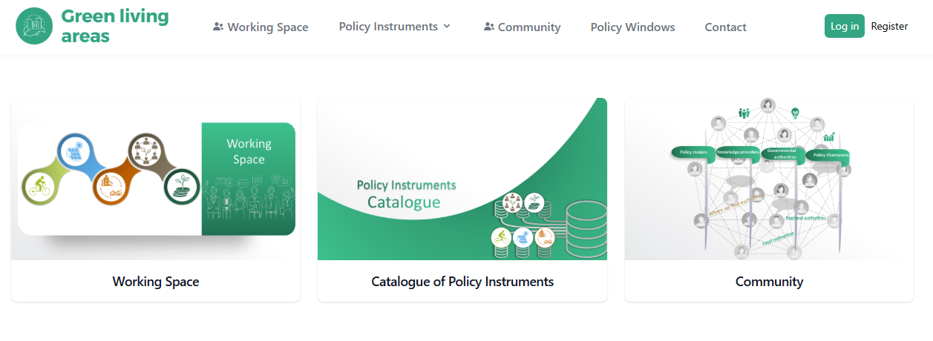

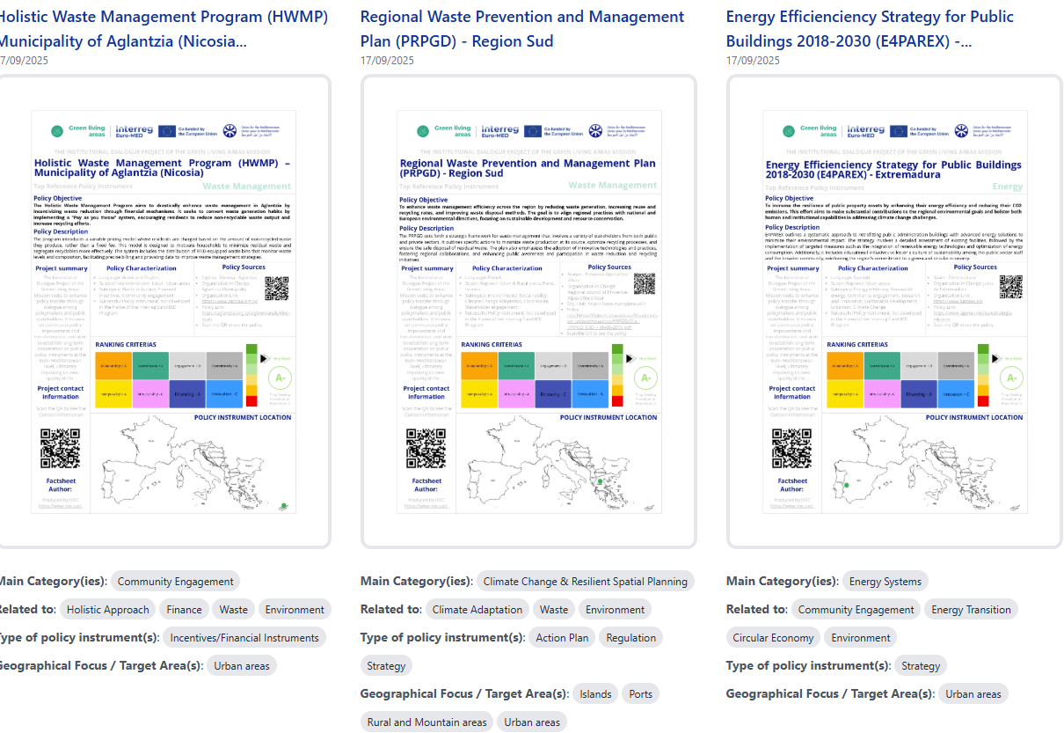
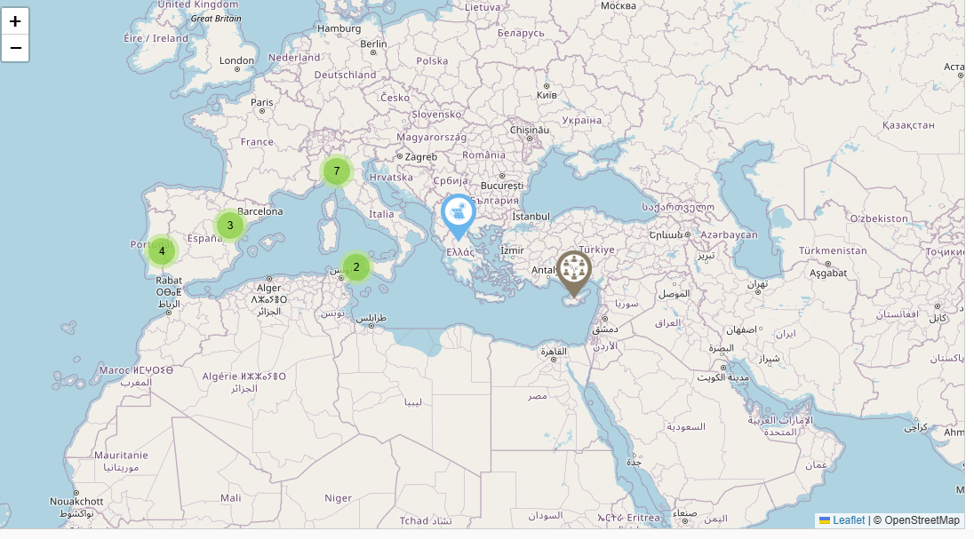
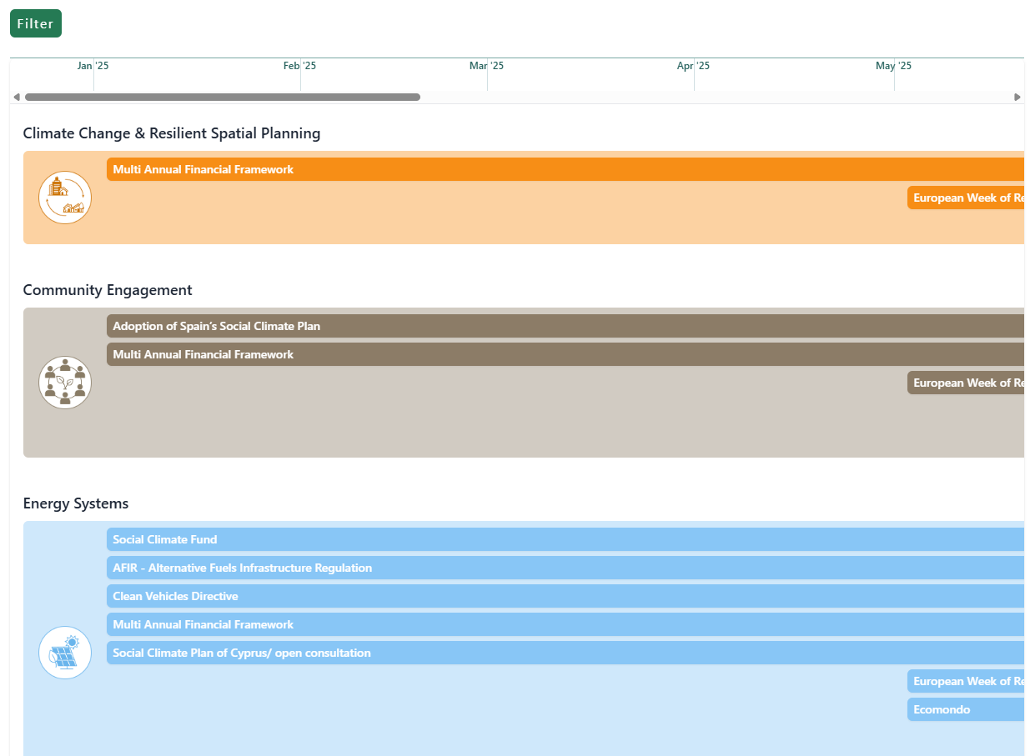
The platform
Working Space
Community
Policy Instruments
Policy Map
Policy Windows
https://greenpolicylab.interreg-euro-med.eu/working-space
https://greenpolicylab.interreg-euro-med.eu/catalogue
https://greenpolicylab.interreg-euro-med.eu/map
https://greenpolicylab.interreg-euro-med.eu/policy-windows

Slide 7





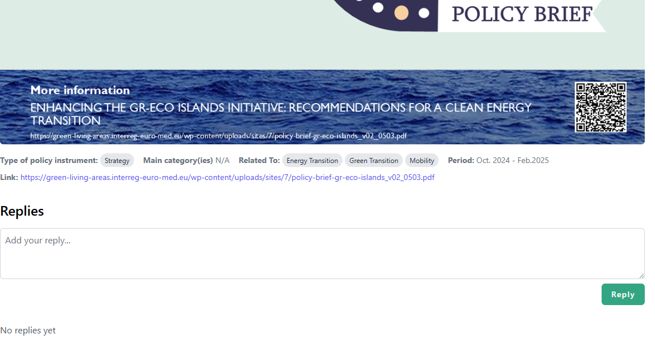
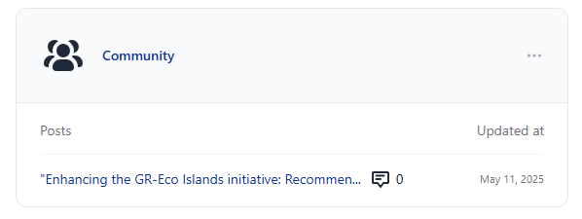
A working space for Green Living Areas to discuss policy-related issues with the community, the core group, the external stakeholders and policy-makers.
Working Space
Community
Working Group 1: Green Mobility
Working Group 2: Green Energy Systems
Working Group 3: Green & Climate Change Resilient Spatial Planning
Working Group 4: Green Community Engagement
Working Group 5: Financing the Green Transition

Slide 8
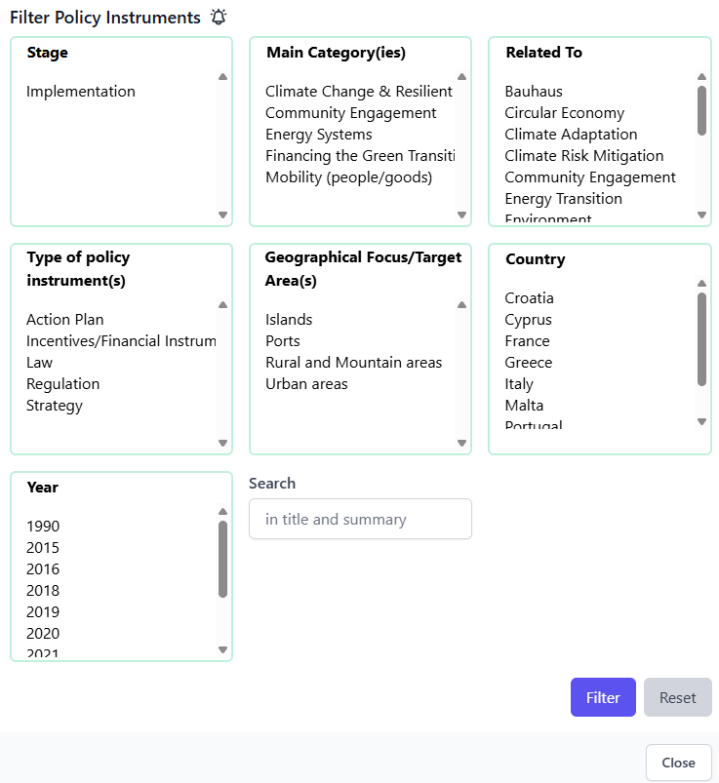
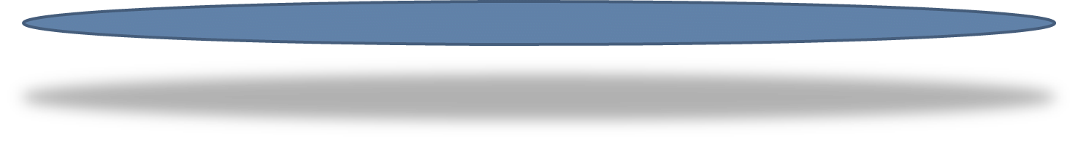
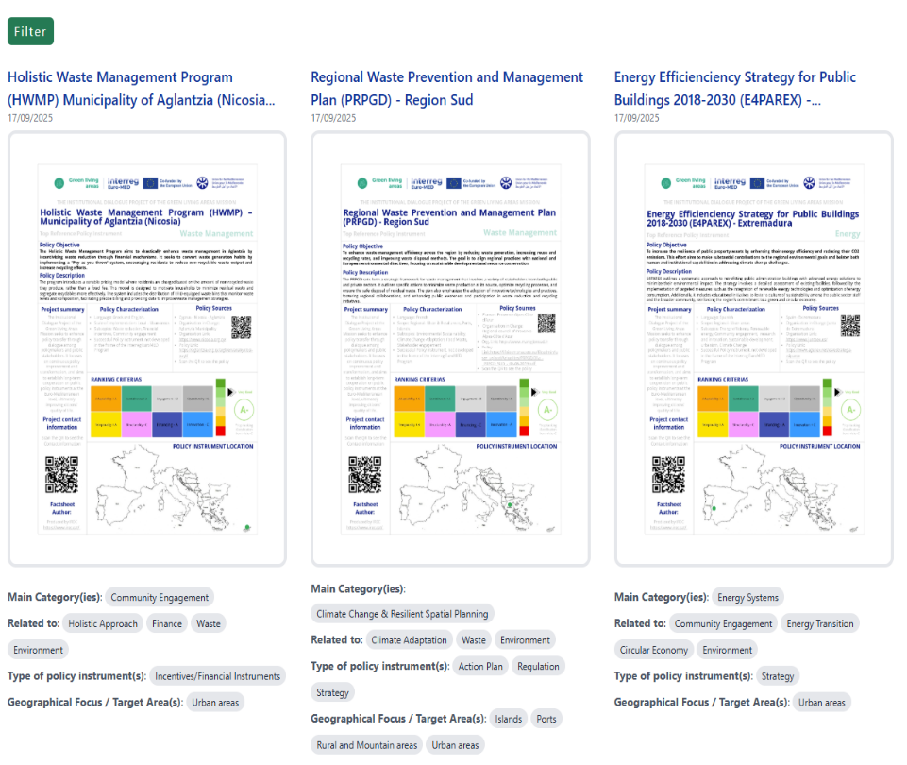
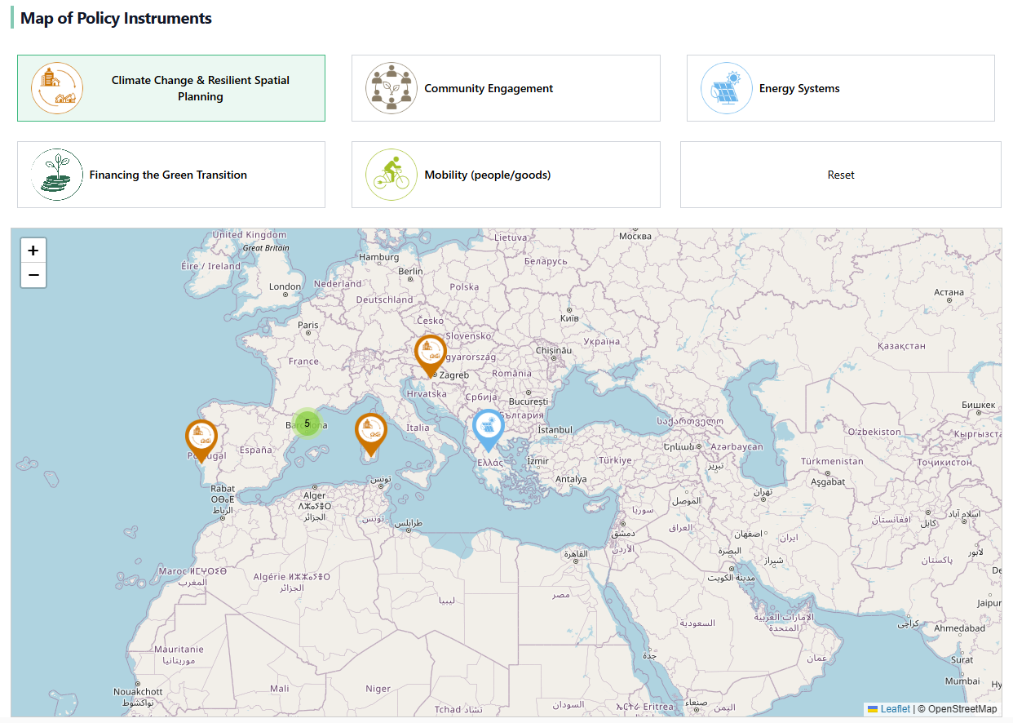
Catalogue of Policy Instruments
Policy Instruments
+
Map of Policy Instruments
Filter
Filter to search for instruments
Search by green living area topic

Slide 9
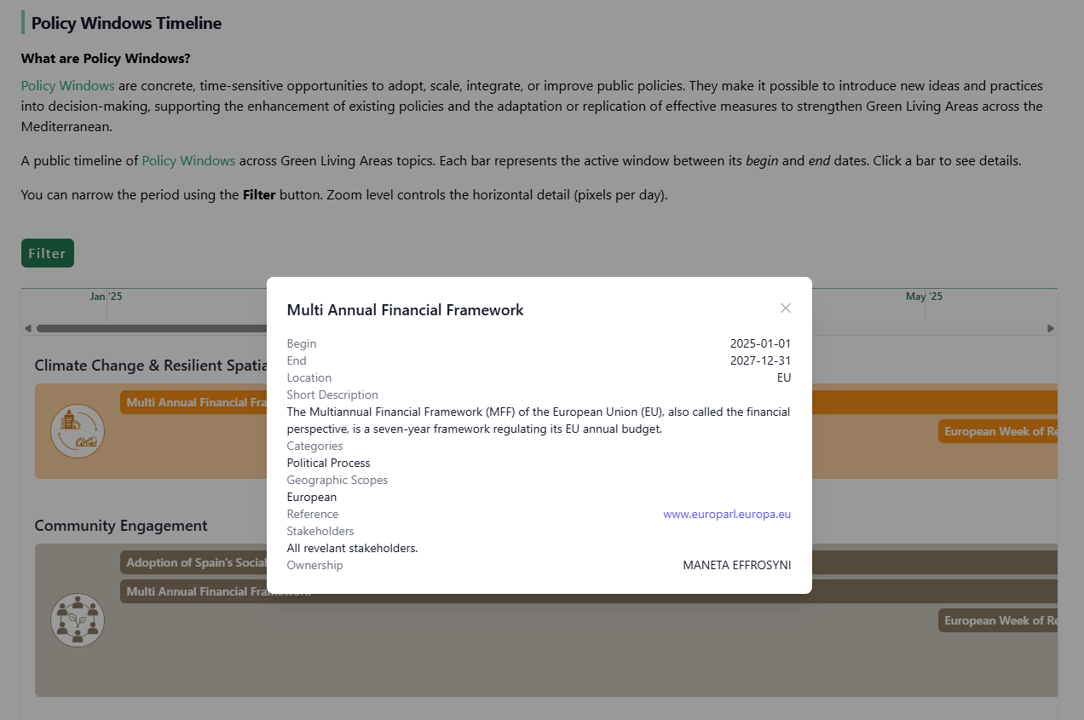

What are Policy Windows?
Policy Windows are concrete, time-sensitive opportunities to adopt, scale, integrate, or improve public policies.
Policy Windows
A public timeline of Policy Windows across Green Living Areas topics.
Each bar represents the active window between its begin and end dates. Click a bar to see details.
Click to see details
Types of Policy Windows

Slide 10
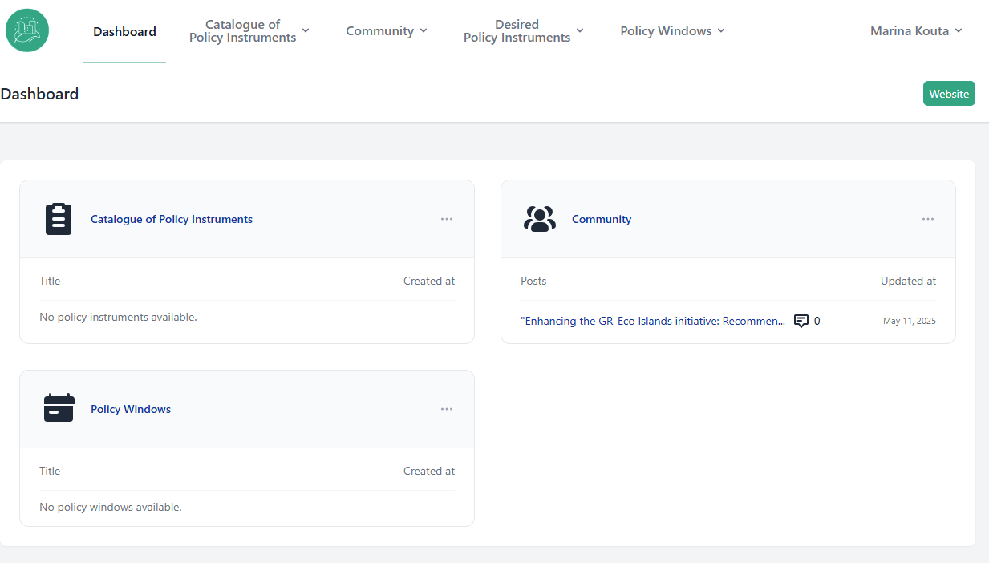
Dashboard
Manage editor’s entries
Here you can ask also for “Desired Policy Instruments”
We identified already developed best practices and policy solutions in the Green Living Areas.
The list of Desired Policy Instruments was designed for you! If you've identified any policy gaps, let us know your recommendations through this section.

Slide 11

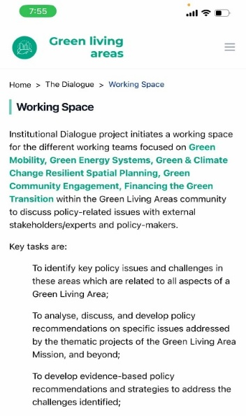
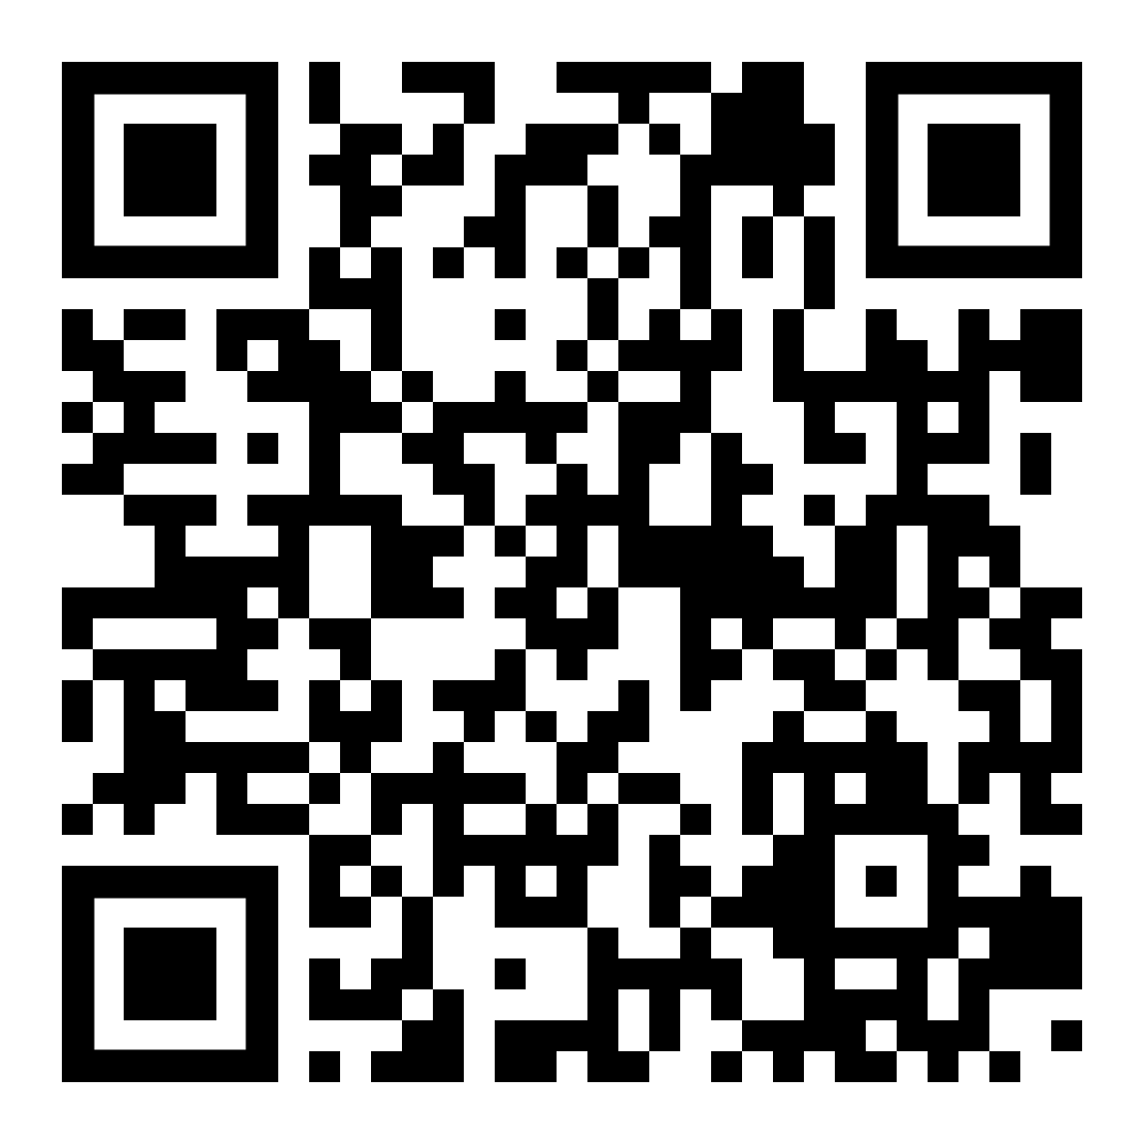
Thanks!

