Slide 1


Turning sludge into a circular resource
in line with Interreg Euro Med & UFM

Slide 2

Sludge Challenge in the Mediterranean
Indicative regional figures – unmanaged sludge remains the critical gap.

Slide 3
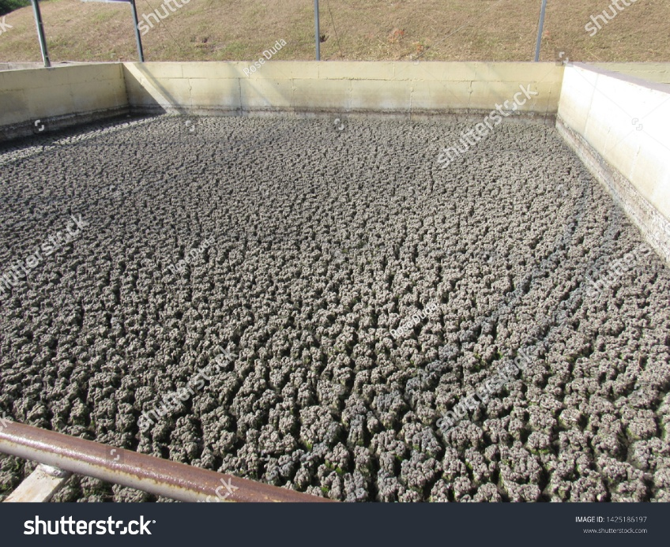
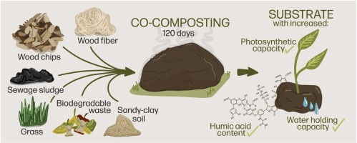
From Sludge to Resource
♻ Circular Economy Logic
• Compost for soil restoration • Energy recovery (biogas, drying) • Nutrient recovery (N & P)

Slide 4


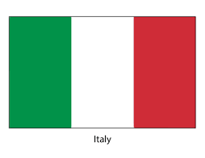

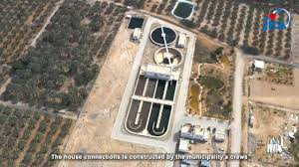

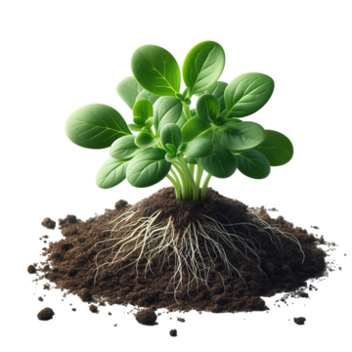
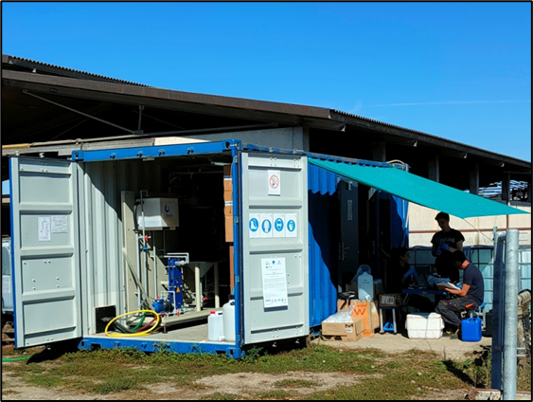
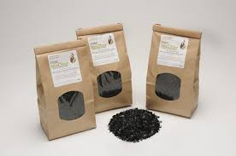

Living Labs and Countries
🌍 4 Cross-border Living Labs:
Testing real circular solutions of sludge, water and nutrients.
Technical innovation combined with governance and policy support.
Common MED challenges and replicable models.
Shared experts across partners.

Slide 5
Key Results & Impact
♻ Sludge Reduction
30–40% at Living Lab sites
🌱 Nutrient Recovery
20–30% (Nitrogen & Phosphorus)
💶 Cost Reduction
10–20% lower disposal costs

Slide 6


Key Results & Impact
Policy & Capacity Impact:
4 Policies Improved
1 Mediterranean Knowledge Platform
400 People Trained
4 Toolkits Developed
4 National Roadmaps

