Slide 1
Interreg NEXT MED Programme
Synergies with the Interreg Euro-MED Missions
MED TALKS. December 16, 2025.

Slide 2
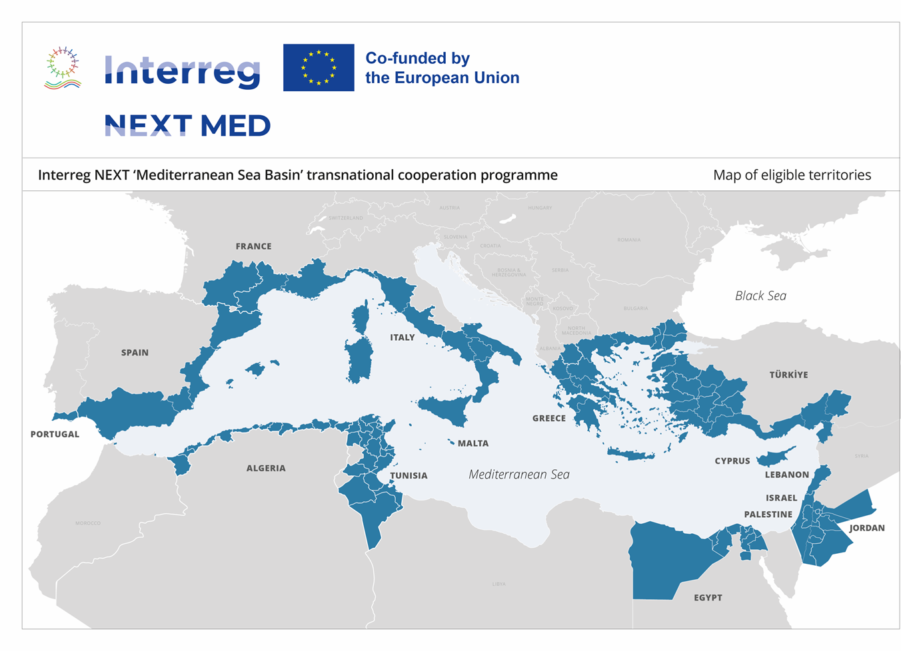
Interreg NEXT MED – Making cooperation happen in the Mediterranean
15 participating countries
100+ territories
200+ million people living in the cooperation area
€263 million in budget
234 projects financed (since 2010)
1700+ partners funded (since 2010)

Slide 3
Our vision : contributing to a better mediterranean
Competitive and smart
Green and low-carbon
Social and inclusive
Multilevel governance

Slide 4
The first generation of Interreg NEXT MED projects
€ 119 Million of EU Contribution
16 projects
22 projects
13 projects
8 projects

Slide 5

Interreg NEXT MED and Interreg Euro-MED missions
A selection of aligned Interreg NEXT MED projects
MATRIX, Waste2Fashion, MEDINCHAMBERS - Boosting Circularity in the Textile Sector
WEEVALUE – Enhancing the Value of Electrical and Electronic Equipment
MedRESOURCE – Turning sludge into valuable resource
INNOVATILE – Driving Innovation to Decarbonise the Ceramics Sector
Euro-med Mission Innovative Sustainable Economy

Slide 6


Interreg NEXT MED projects and Interreg Euro-MED missions
A selection of aligned Interreg NEXT MED projects
MEDFIREWISE & SIMMER - preventing wildfires
MedJICARP, MEDPROACT & SHARE4MED - protecting our Mediterranean Sea against Climate Change
YOUTHCARE4PLANET – Mediterranean Youth Taking Action to Protect the Environment
MEDSHIFTGREEN - cultivating Green Innovators
Euro-med mission Natural Heritage

Slide 7

Interreg NEXT MED projects and Interreg Euro-MED missions
A selection of aligned Interreg NEXT MED projects
NBS4MED – Developing nature based solutions for climate resilient Mediterranean cities
SHAREN - Empowering Mediterranean Historic Centres with Energy-Sharing and Renewable Solutions
GREENMEDPORTS – Cutting emissions of Mediterranean ports
REST4GREEN - Integrating Energy Efficiency, RES and Smart Energy Conservation to Improve Quality of Life in the Mediterranean
STORM - Integrating Seasonal Thermal Energy Storage in the Mediterranean Region
RESWATER - Leveraging Non-Conventional Water Resources for Resilient Cities
GOVGREENMED - Building a Greener Mediterranean through Inclusive Governance Models
JADEITE – Ensuring a Green and Just Transition through Participatory Governance
Euro-med mission Green Living

Slide 8

Interreg NEXT MED projects and Interreg Euro-MED missions
A selection of aligned Interreg NEXT MED projects
CLUSTERATLAS4MED - Empoyering a data driven ruraL sustainable tourism for Mediterranean SMEs
RETOUR - Building Resilient SMEs in the Tourism Industry
SMAC – Developing a Sustainable Model for Accommodation MSMEs
Euro-med mission Sustainable Tourism

Slide 9
Interreg NEXT MED Programme
ernoux_vina@gva.es

