Slide 1
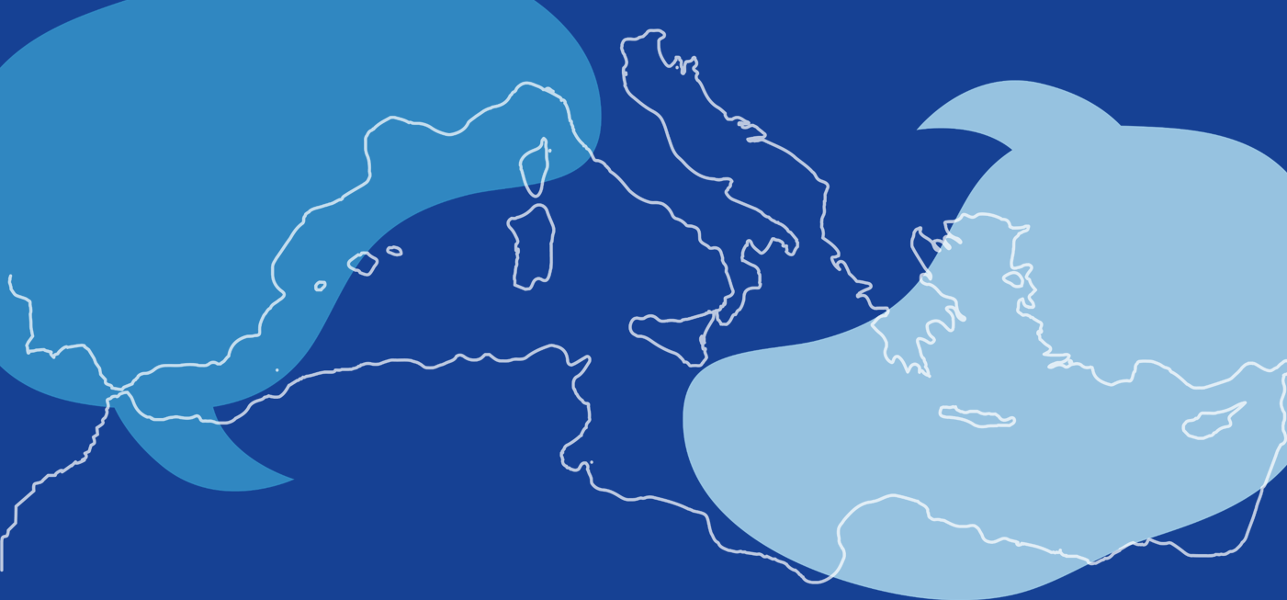

MED TALKS
3rd edition Fostering dialogue between Northern and Southern Shores
16th December 2025
Key achievements & transfer pathways
Sustainable Tourism Mission

Slide 2
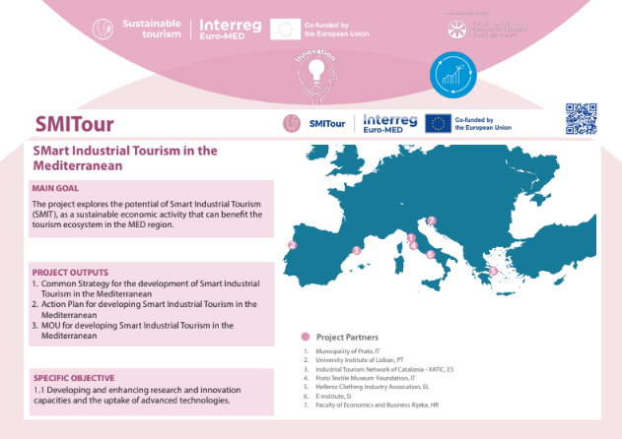
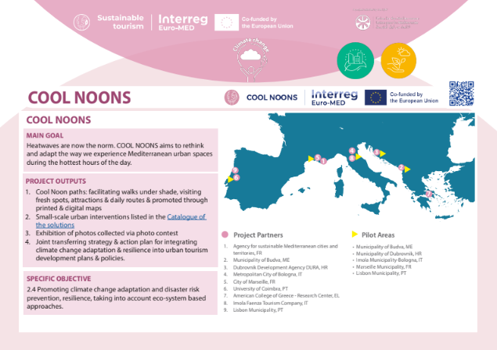
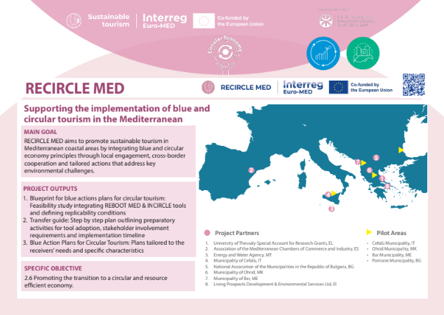
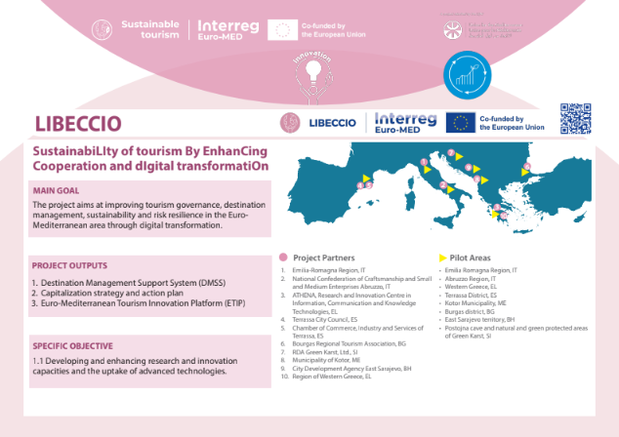
The Sustainable Tourism Mission
2 Governance Projects
1 Institutional Dialogue project
2 Strategic Territorial Projects
1 Thematic Community project
2 Study projects
20 Thematic Projects
12 Test projects
6 Transfer projects
+50
AOs
+200
AOs
2 Study + Test + Transfer projects
Find all the information of the Thematic Projects of the Mission here!!

Slide 3
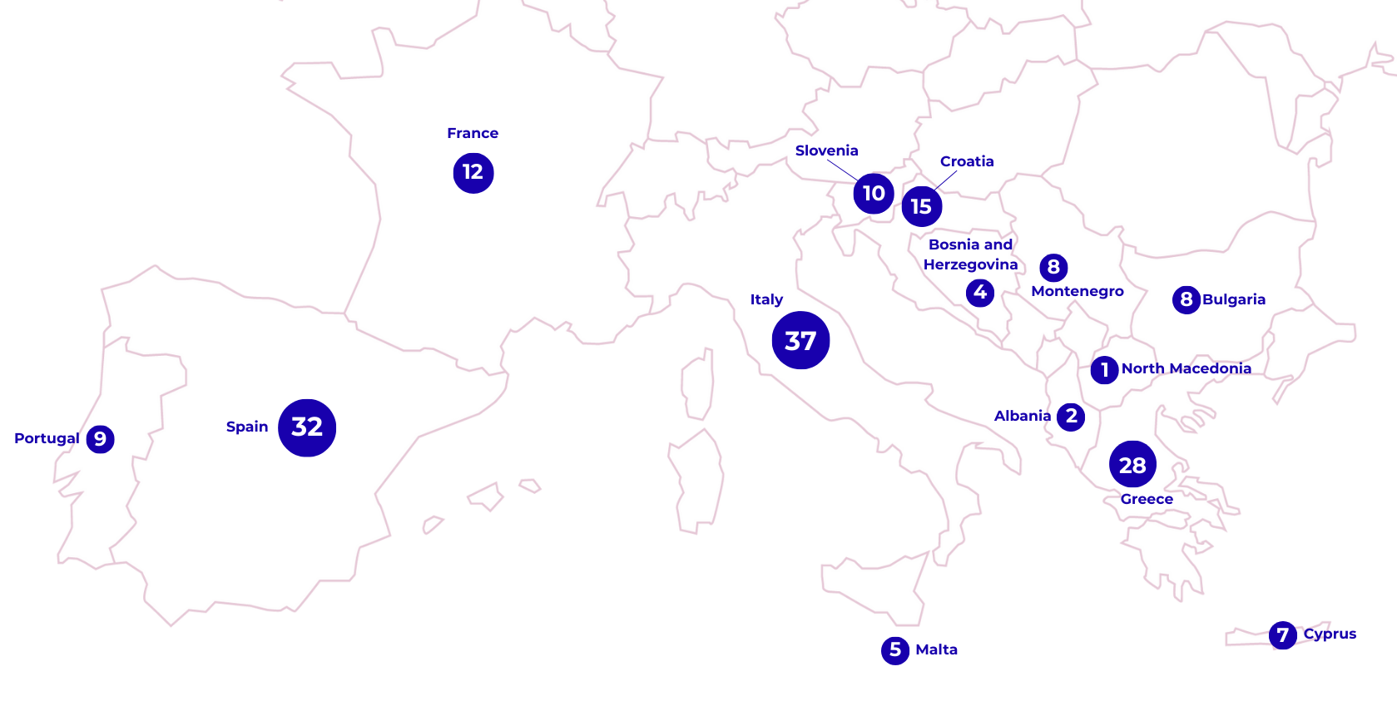
The Sustainable Tourism Mission
A community with more than 180 different organisations
A community of projects funded by a total budget of 45,80M €
+40
Regional public authorities & development or tourism agencies
+25
Networks, NGOs, International organisations
+35
Local public authorities & development or tourism agencies
+15
Business support organisations
+30
Higher education and research institutions
+10
SMEs & enterprises

Slide 4
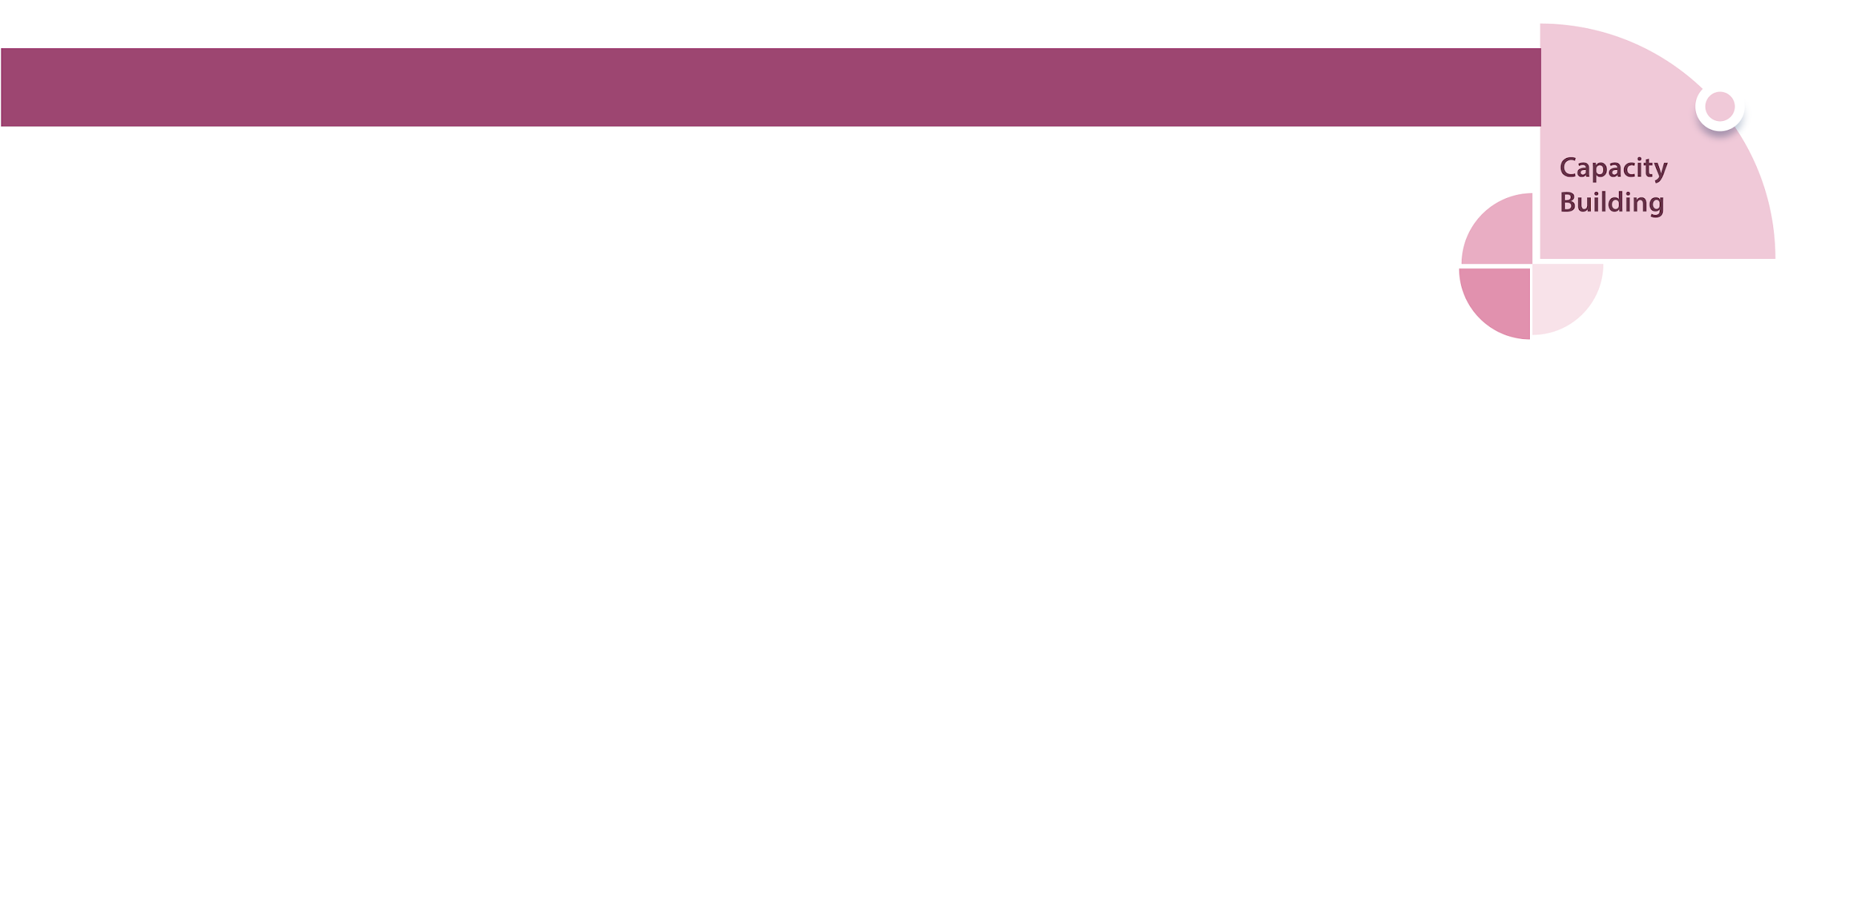
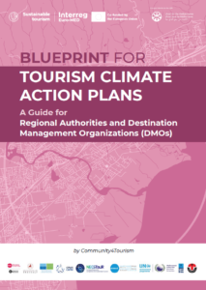
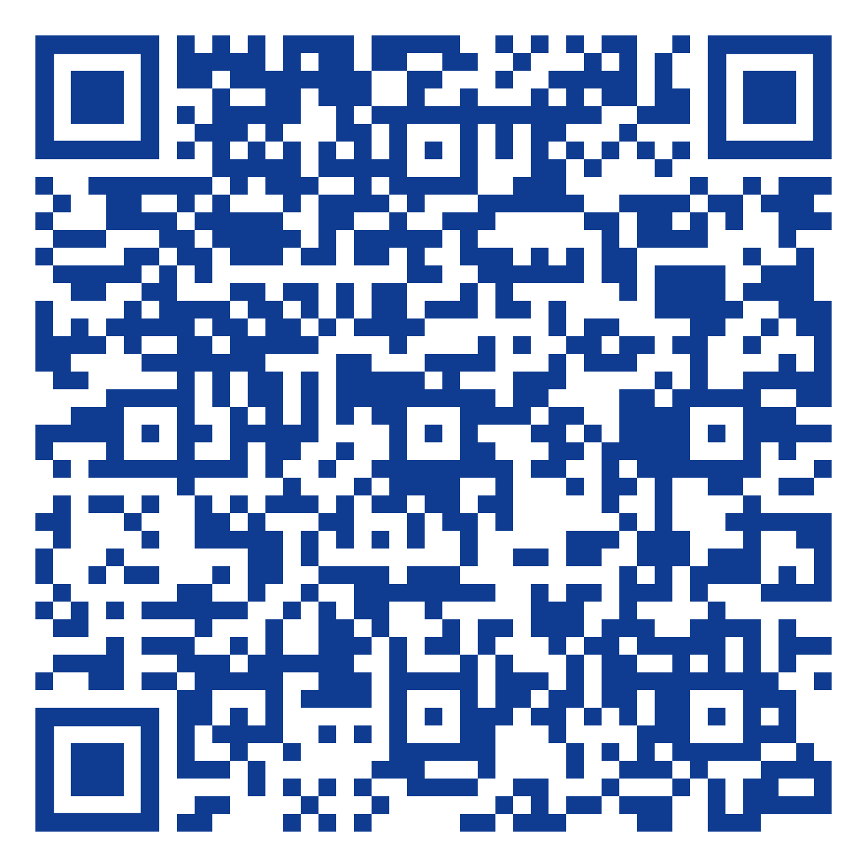

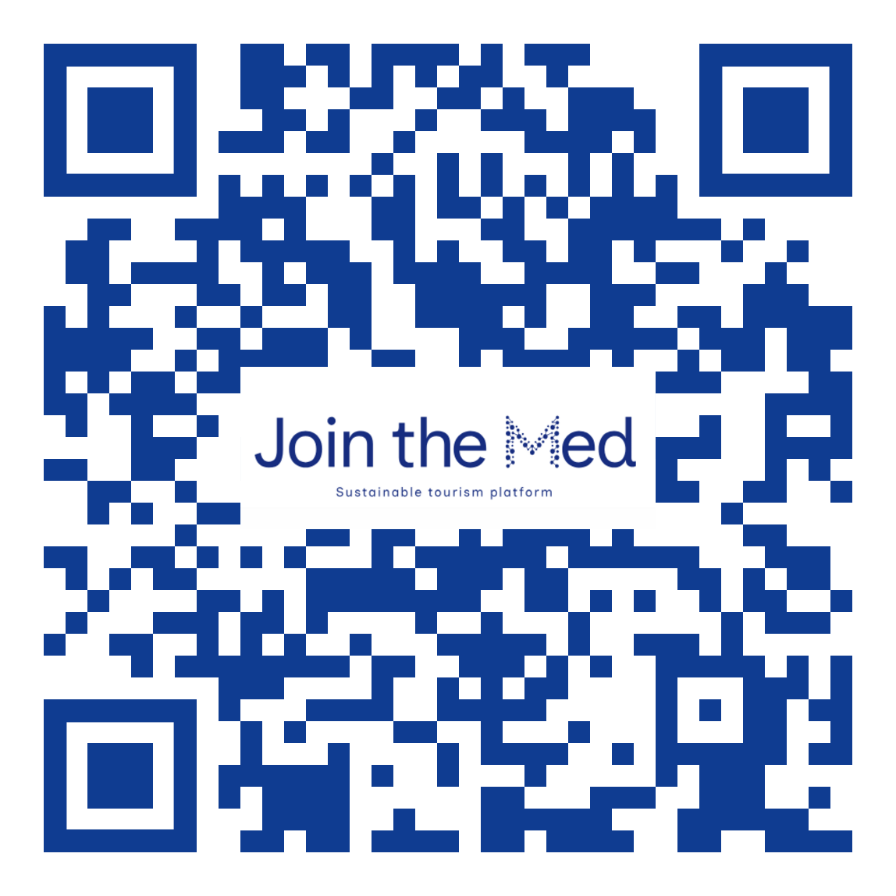
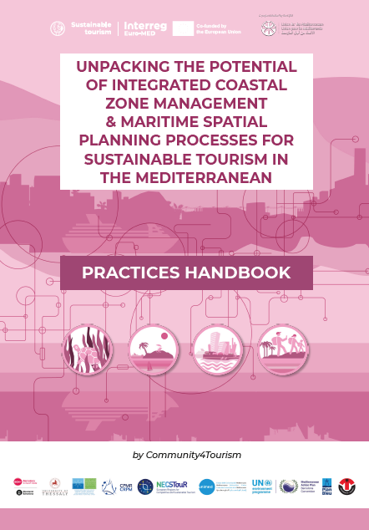
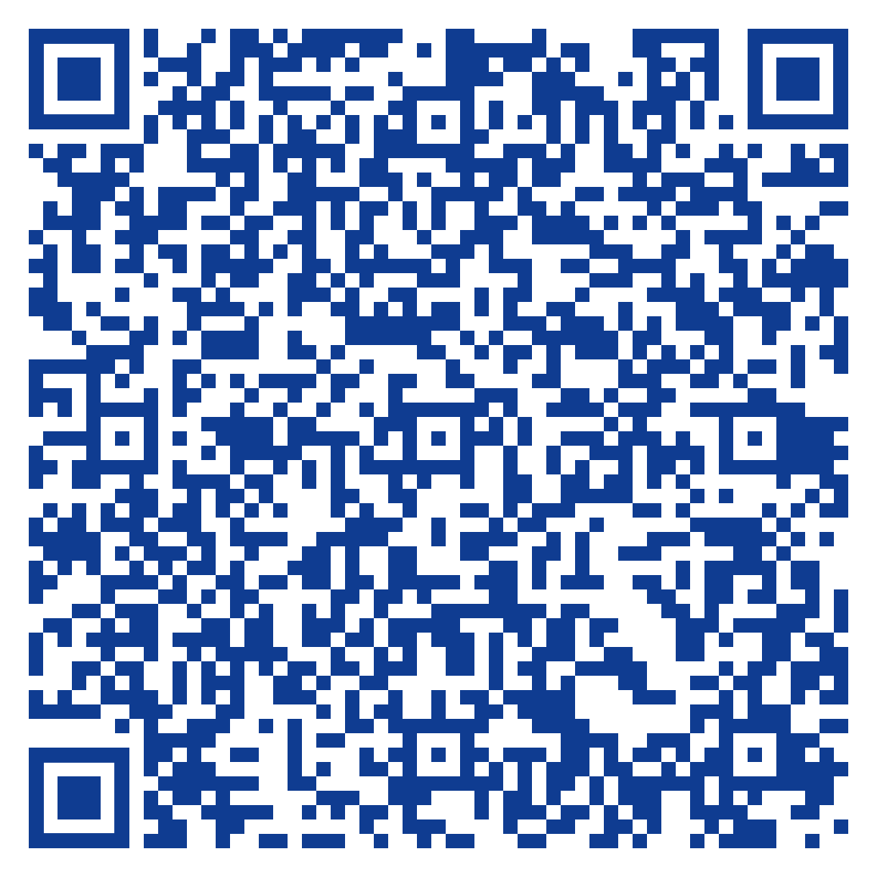
Mission’s Objectives | Activities and Resources
BLUEPRINT FOR TOURISM CLIMATE ACTION PLANS
THE MED CLUSTERS & WORKING GROUPS
(open to participation!)
by C4T
ICZM & MSP PRACTICES HANDBOOK FOR TOURISM
JOIN THE MED- KNOWLEDGE HUB

Slide 5
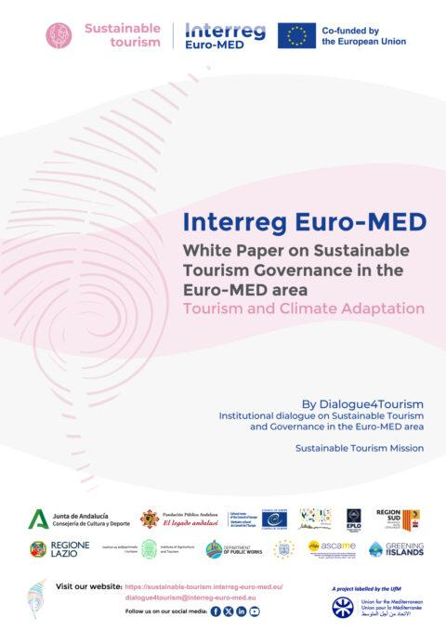
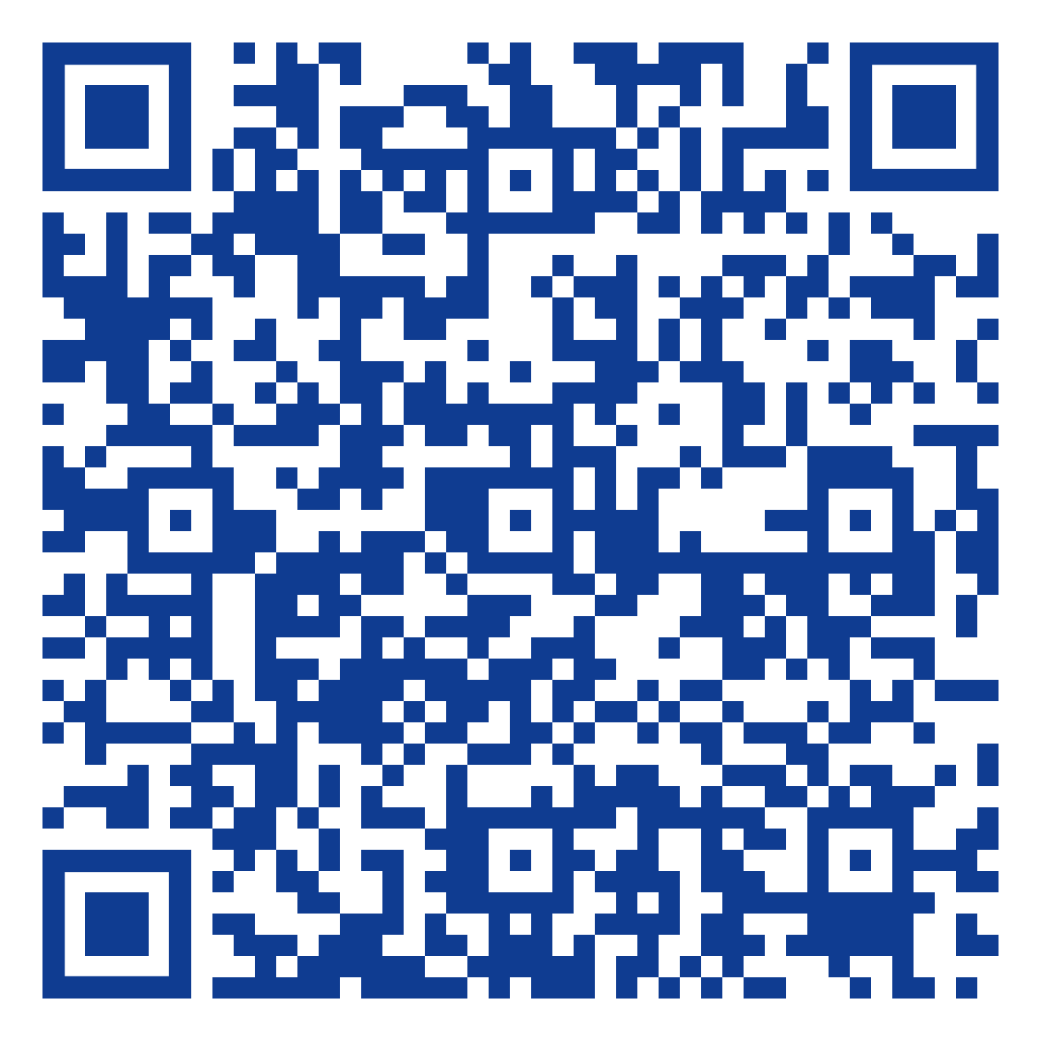
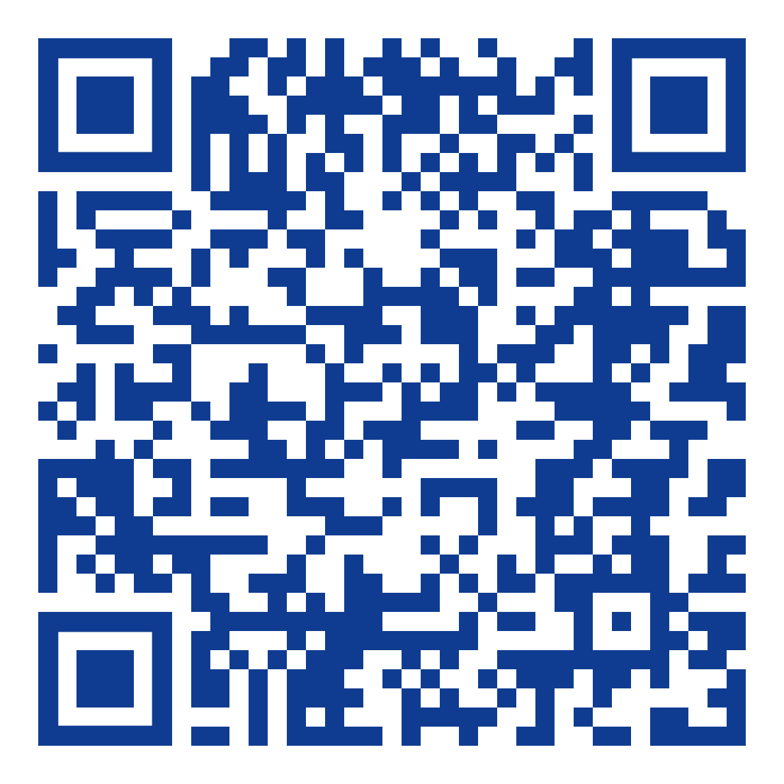
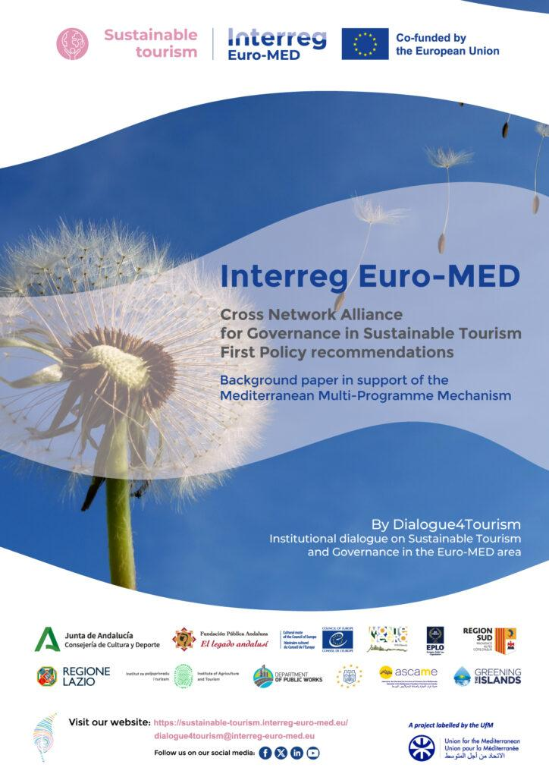
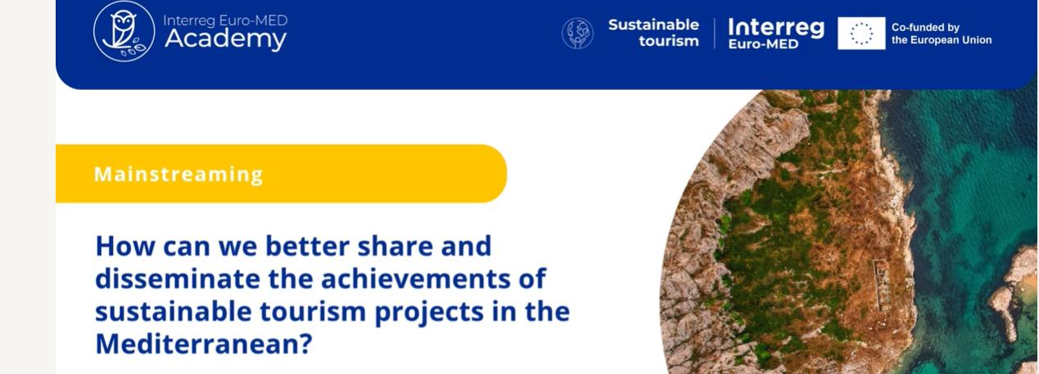
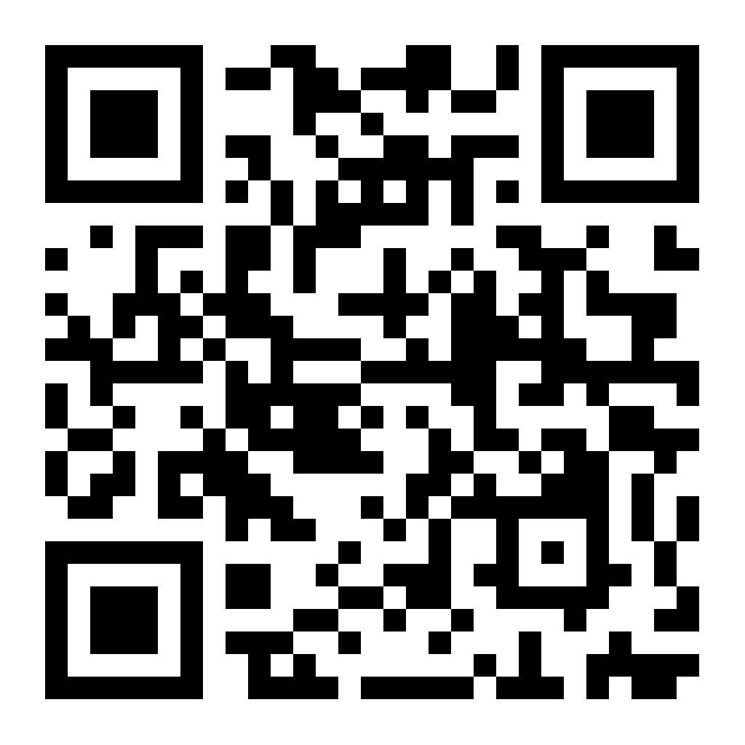
Mission’s Objectives | Policy tools
THE WHITE PAPERS ON SUSTAINABLE TOURISM GOVERNANCE IN THE EURO-MED AREA (2 in preparation)
THE NETWORK OF SUSTAINABLE TOURISM OBSERVATORIES
(open to participation!)
Upcoming publication:
Practical guide for
Sustainable Tourism
Observatories.
Transferable solutions
by D4T
MOOC ON TRANSFER & MAINSTREAMING IN THE INTERREG EURO- MED ACADEMY soon online first modules!
FIRST POLICY RECOMMENDATIONS OF THE CROSS-NETWORK ALLIANCE IN SUSTAINABLE TOURISM (Upcoming publication: II policy recommendations)

Slide 6
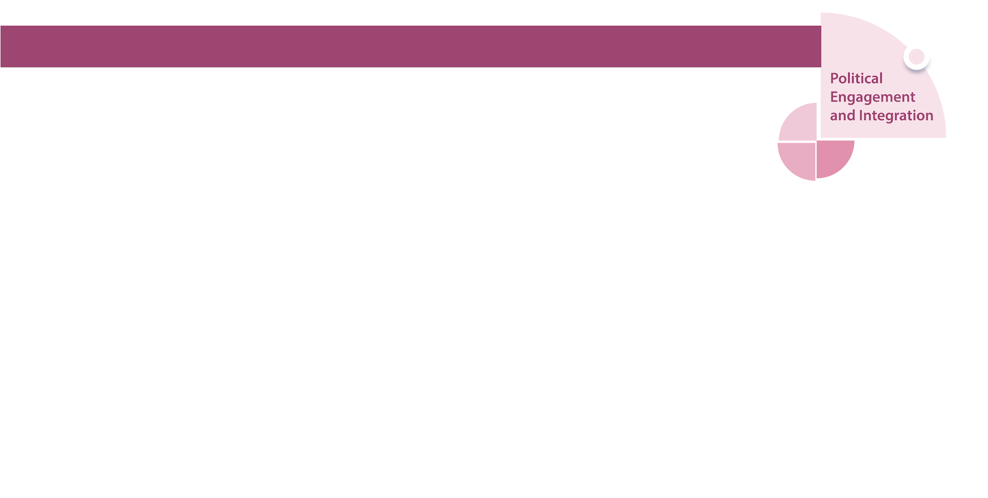
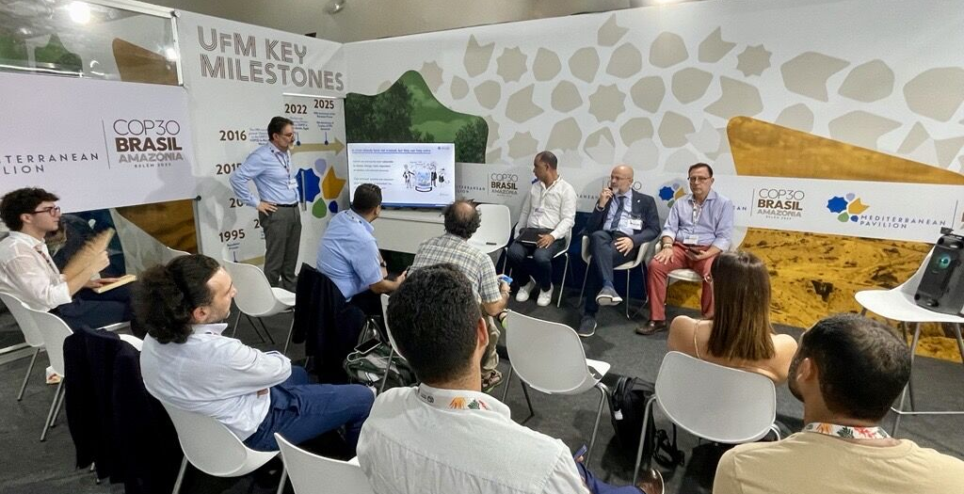
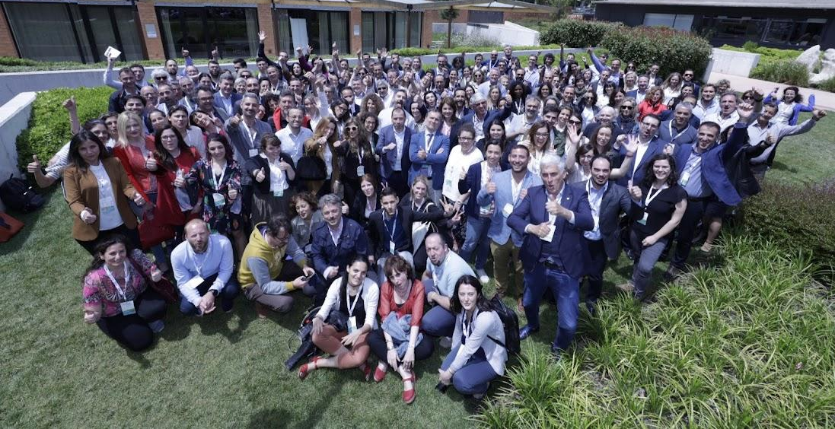
Mission’s collaborations with Southern & Eastern MED partners
DRIVING CHANGE TO CLIMATE ACTION AT COP’30
Presentation of a preview of the White Paper on Islands as Hubs for Sustainable Tourism by Greening the Islands -partner of the Sustainable Tourism Mission- in collaboration with UfM & with the active participation of stakeholders from Southern MED at the Mediterranean Pavilion in COP30 (Belém, Brazil) in November. Among them, the Tunisian Tourism National Office (TNTO) and the University al-Manar (Tunis, Tunisia).
Some good practices from the Mission’s Thematic Projects were highlighted showcasing our commitment to climate action and sustainable development.

Slide 7
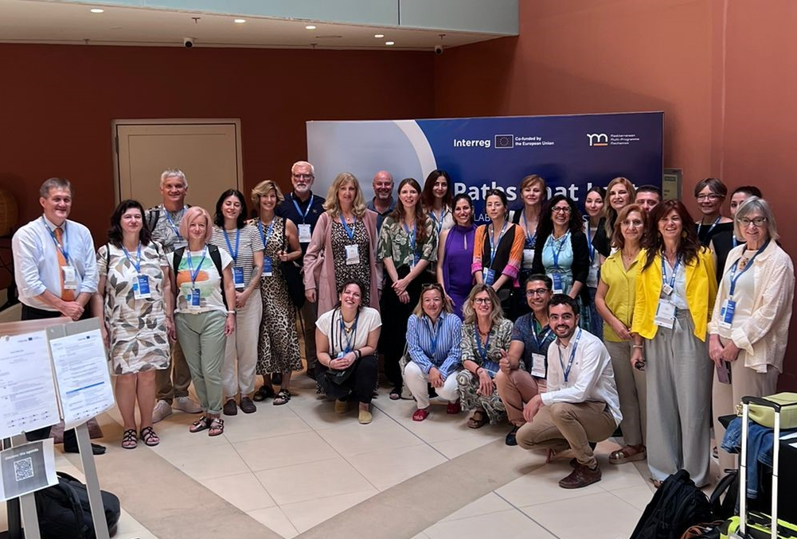
Mission’s collaborations with Southern & Eastern MED partners
TOURISM GOVERNANCE WORKSHOP: COORDINATION & SOUTHERN MED ENGAGEMENT
Southern MED stakeholders joined the workshops on Shared & Strategic governance of the tourism and Tourism and green transition coordinated by this Mission alongside with other Interreg Programs during the Mediterranean Multiprogramme Mechanism Paths that last event organised by the Interreg Euro-MED in coordination with other Interreg Programmes.
Participants engaged in dynamic discussions on governance models. Representatives from the Interreg Next MED CreSInMED and Climed Projects (among others) with partners from Turkey, Jordan, Lebanon and Tunisia actively contributed to this exchange with members of the Sustainable Tourism Mission.

Slide 8
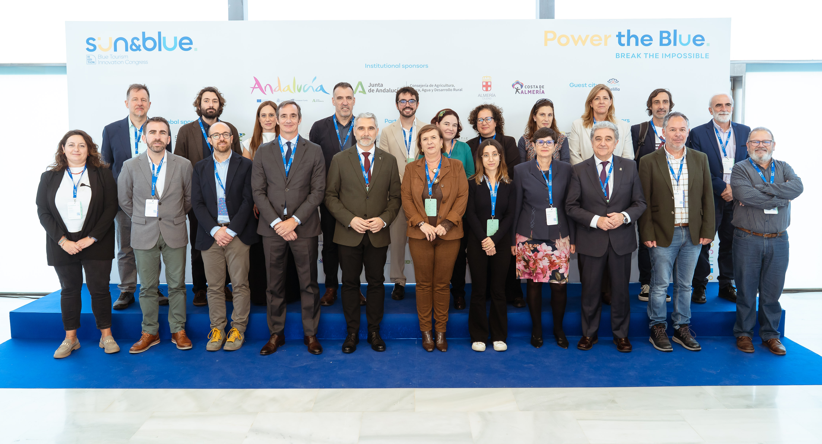
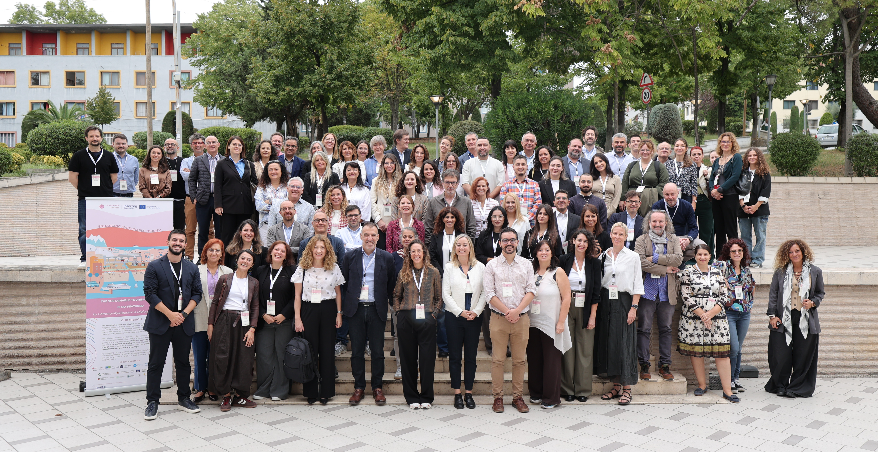
Mission’s collaborations with Southern & Eastern MED partners
SUSTAINABLE TOURISM COMMUNITY: 2nd Annual Meeting (October, Tirana) - An expanded collaboration within the Sustainable Tourism Mission: 22 projects, Joint Secretariat, Mission representatives and Associated Partners with the participation of the University of Jordan, as AP.
Mediterranean Multi-Program Mechanism (MMM) – promoting Interreg projects in Blue Economy at the Sun&Blue Congress together with NEXT MED or WestMED Initiative.
Networks to strengthen the cooperation and exchanges in the Mediterranean - CPMR, Medcities, UNIMED, etc.

Slide 9
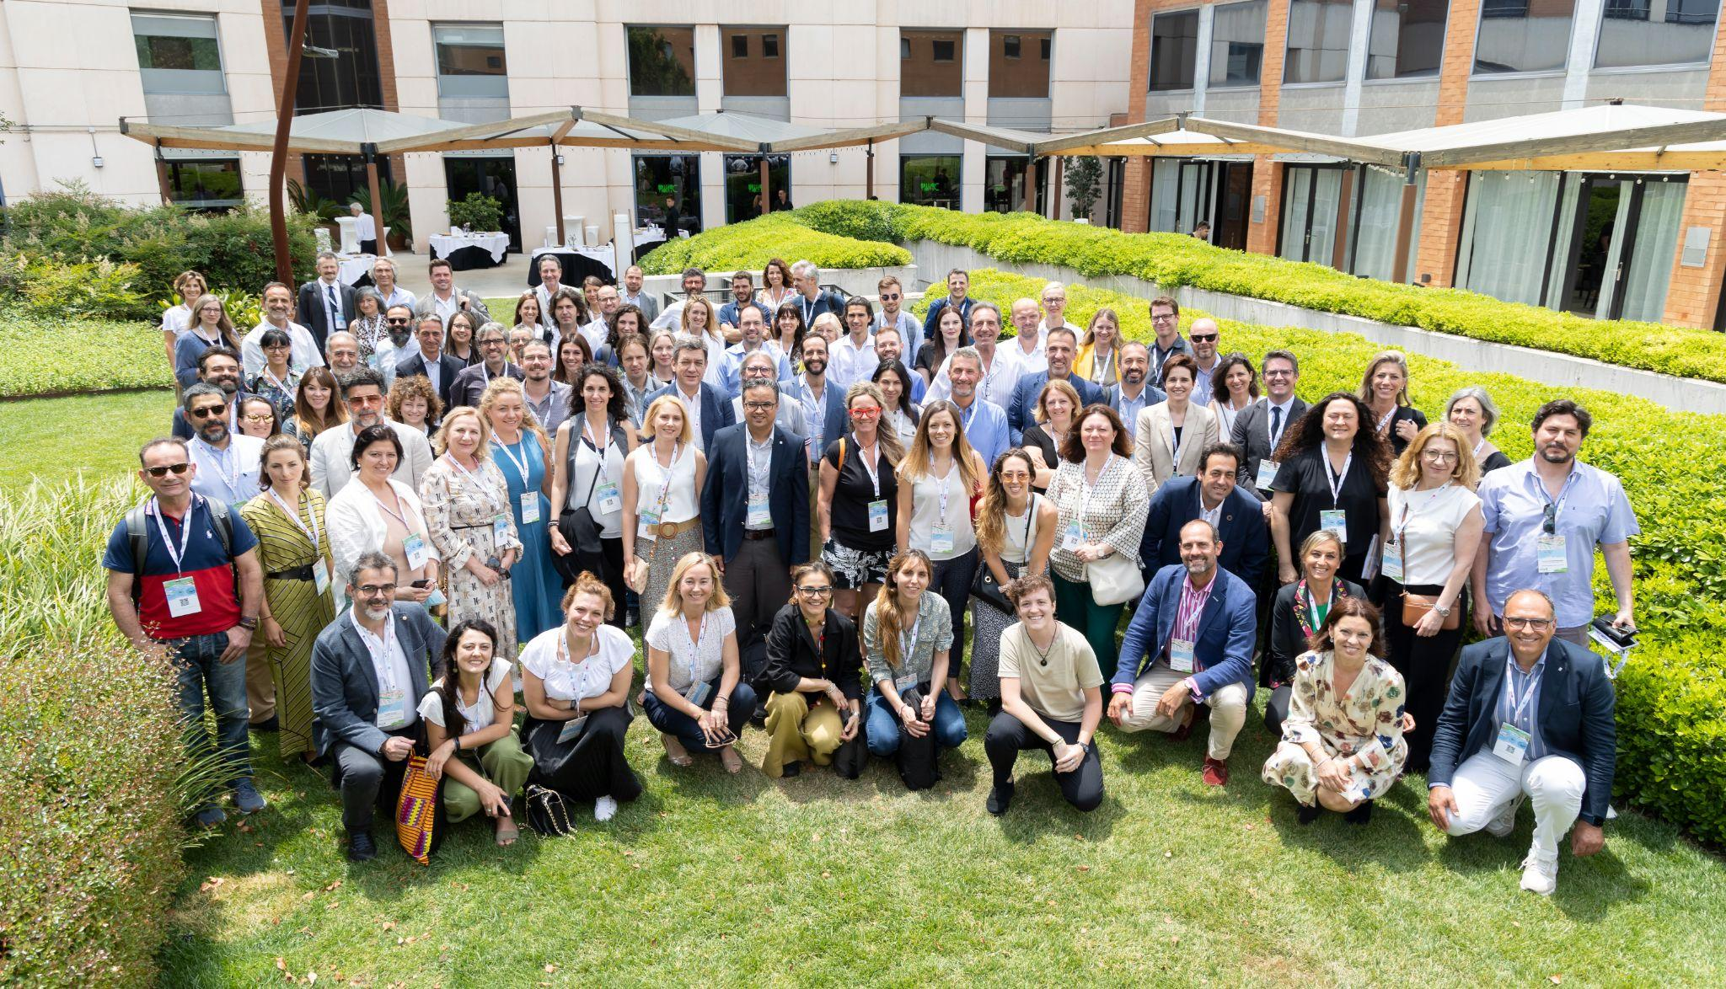
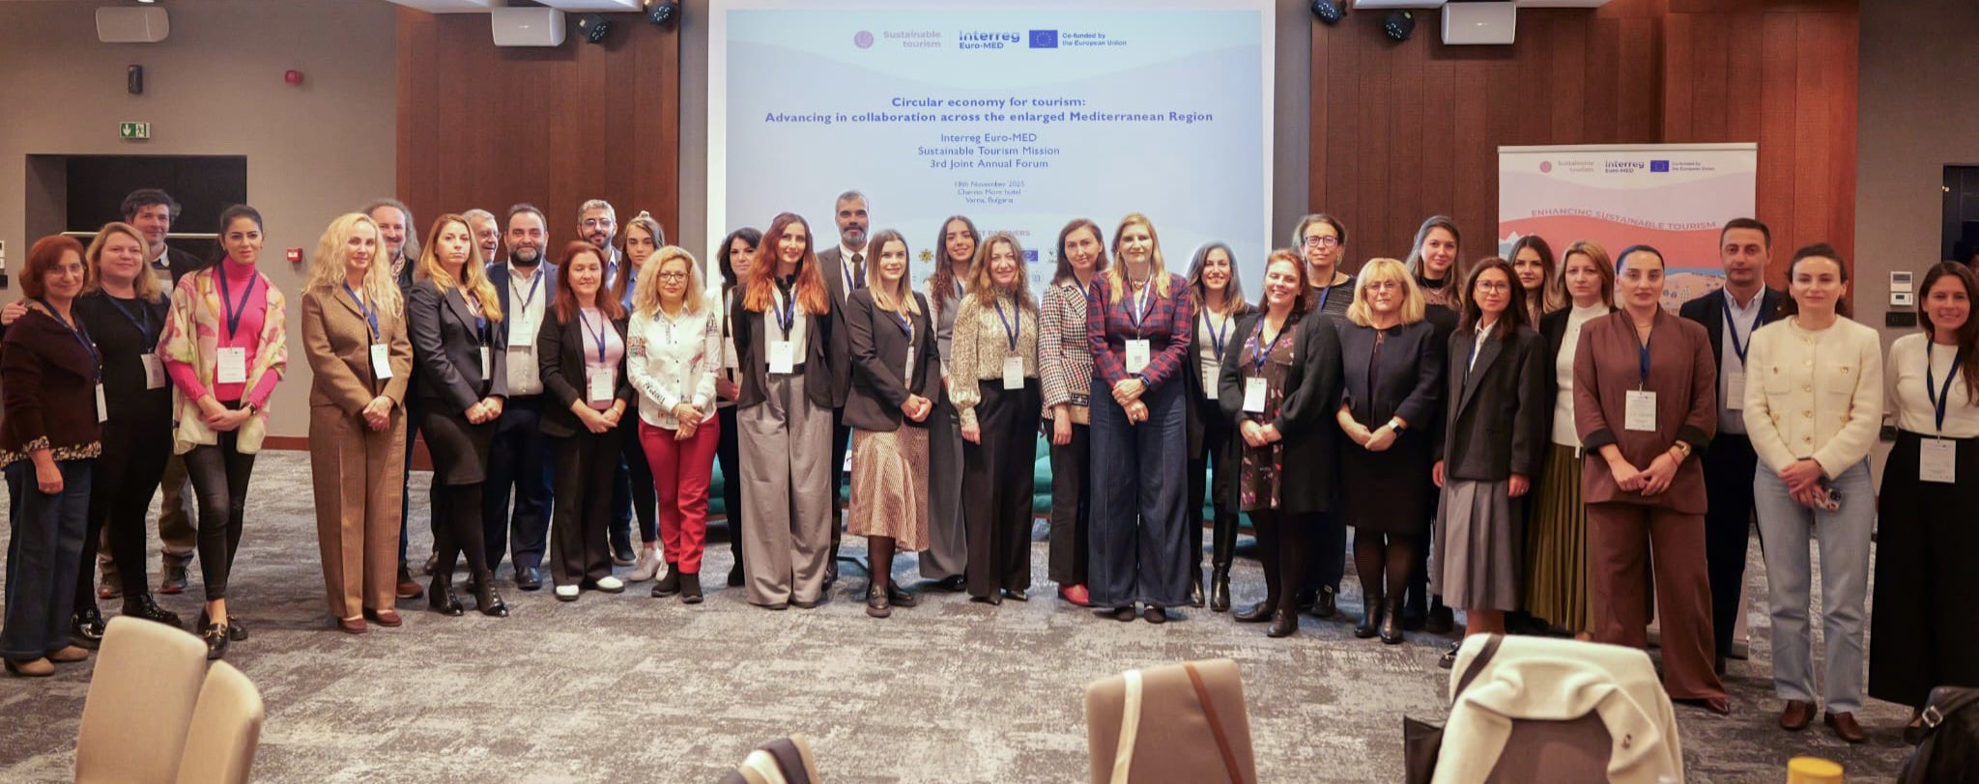
Upcoming activities to participate
III MED SUSTAINABLE TOURISM CONVENTION
📅 Save the Date!
📍 18 & 19 June 2026, Barcelona
A key event to boost the sustainable Tourism in
the MED, showcasing practices and results from
the Mission and involving key stakeholders of the
tourism ecosystem around our key topics.
II SESSION OF THE SUSTAINABLE
TOURISM POLICY LABS
📅 Save the Date!
📍 19 March 2026, Nicosia (Cyprus)
Flagship event hosting a multi-actor
policy discussion on transfer of
results & tools of our Mission’s projects
under the auspices of the Cypriot
Presidency of the Council of the EU.

Slide 10
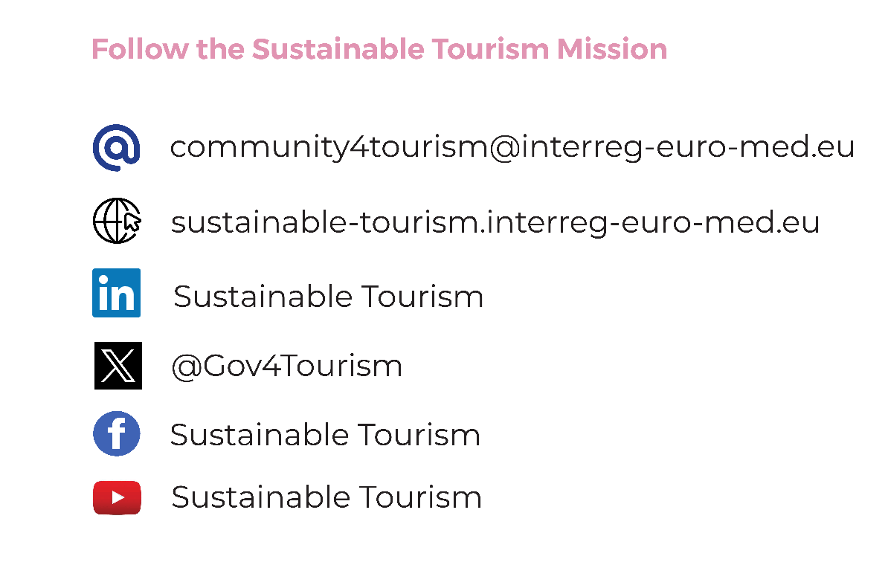

Slide 11
Thank you for your attention!
Sustainable Tourism Mission| sustainable-tourism@interreg-euro-med-eu

