Slide 1
Med Talks 2025 Green Living Areas Mission 16/12/2025

Slide 2
Our mission in summary – our results in 2025
25 Thematic / Strategic Projects divided into 5 thematics working groups
1 in-live and 2 Online Thematic Working Group sessions
8 Territorial Antennas live events in MED area
1 Thematic Community event
Participation at European Sustainable Energy Week (EUSEW) and European Week of Regions and Cities with presentation of solutions from thematic projects.
1 institutional Policy Dialogue (implemented in the frame of the EUCLID Policy Hub) with the support of Euro-Mediterranean stakeholders (Core Group members)
4 Policy briefs
1 EUCLID collaborative platform of policy-oriented solutions, notably available for stakeholders from the Southern shore of the Mediterranean
Governance Projects
(Thematic Community / Institutional Dialogue)
Green Living Areas Mission
Thematic
Projects
Associated
Partners
DIALOGUE
COMMUNITY
DIALOGUE
COMUNITY
DIALOGUE
Key Euro-Mediterranean
Stakeholders
COMMUNITY
Key objectives | Key achievements
Building the community and amplifying the solutions | Analyzing the transferrability of the TP solutions
Amplification of policy instruments | 9 policy instruments presented with identification of takers

Slide 3
Our technical-oriented results
Territorial Antennas (8 live events is Slovenia, Spain, Croatia, Italy, Greece, BiH, Albania and Bulgaria) which serve as :
National entry-point of the Green Living Areas Mission: TAs operate as a reference contact for the community in their country, and the entry-point for any external stakeholders interested in the community results or synergies. The TAs help disseminate calls and information coming from the TPs using the national language or respond to requests and expressions of interest.
Ensure effective dissemination of solutions and results and operate as transfer facilitators .
Work as solution mainstreaming.

Slide 4
Our technical-oriented results
Thematic Community -ETU toolbox with description of the main transferable solutions from thematic projects.
Brochure: Catalogue of solutions to be integrated in ETU Platform.
Thematic Community Event: Forum, co-creation workshops, training (Barcelona, May 2025).
ETU Matrix:
Participation in European Fairs (EUSEW - EUWRC): focus on solutions from the TPs through the presentation of their results.
Online Thematic Working Group sessions: focus on the deliverables/outputs of TPs.
Starting work on Joint Technical papers.

Slide 5
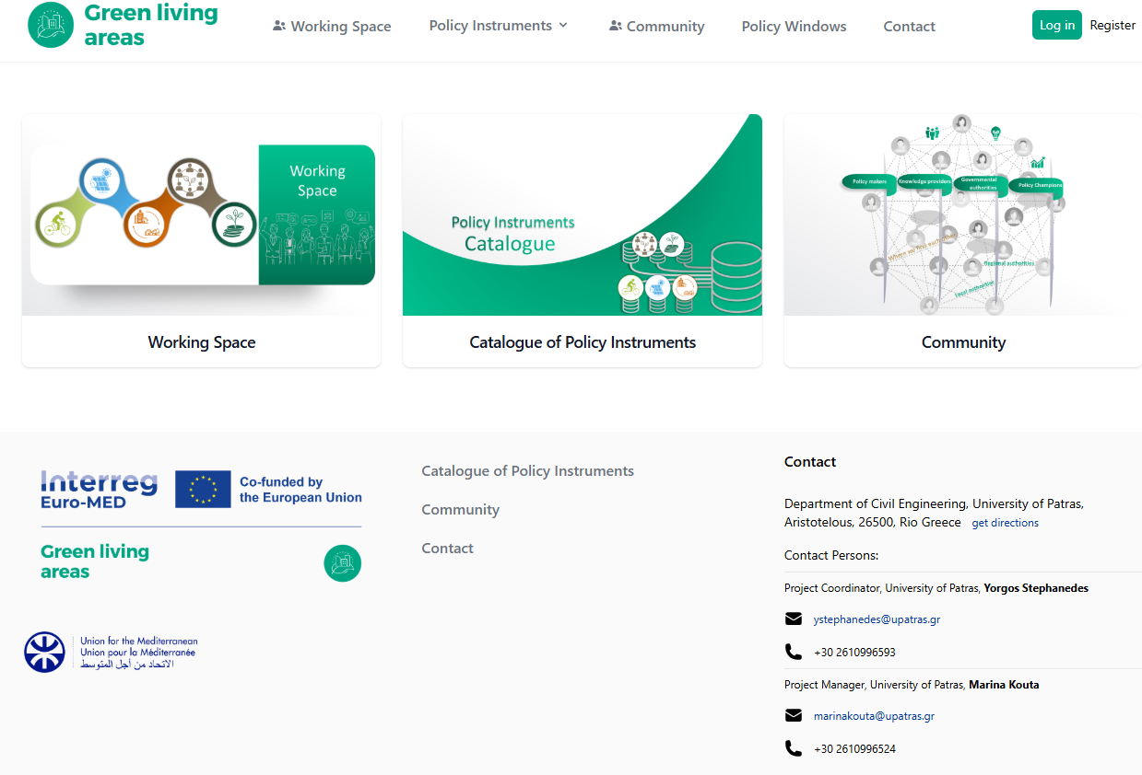
Our policy-oriented results
The Institutional Dialogue Process:
At public level, the Institutional Dialogue Process is a unique opportunity to experiment a concrete and effective use of policies in the various Green Living Areas Aspects:
The objective is to identify/ exchange with / engage policy-oriented stakeholders to replicate, adapt and upscale public strategies, plans and policies.
The benefits of participating in the Institutional Dialogue Process are:
Adopting an action-oriented approach
Discussing existing/re-use/new policy instruments
Sharing gained knowledge
Enriching solutions through dialogue
→ Through the EUCLID collaborative platform of
policy-oriented solutions:

Slide 6
Our policy-oriented results
The first two Institutional Policy Dialogues were held October 2024 and 2025, in Brussels, back-to-back with the European Week of Regions and Cities.
The events brought together key Euro - Mediterranean stakeholders to discuss and analyse the selected policy champions from Green Living Areas’ key focus areas (6):
1. Green Mobility: Policy champion: Sustainable Urban Logistics Plan (SULP) - Bologna, Italy
2. Renewable energy and economic development: Policy champion: Chalki Island, in the frame of GR-eco Island initiative and with the support of DAFNI Network - Greece
3. A strategy for designing and implementing mobility hubs in the frame of the GREENMO thematic project, with the added value of the case study of the city of Antwerp, Belgium.

Slide 7
Our policy-oriented results
4. A decision-supporting policy framework designed to help local authorities plan energy transition in the frame of the LOGREENER thematic project.
5. Set of "nudging" (behavioural change) strategies for urban climate change mitigation and adaptation, in the frame of the NUDGES thematic project,
6. Partnership between local authorities and academia for the sustainable regeneration of inner territories, in the frame of the BAUHAUS4MED thematic project,
7. A Cooperative Model for Energy Communities in Catalonia, Spain.
8. The Green City Action Plan (GCAP) of the City of Karlovac, Croatia, and the Thessaloniki 2030 Climate Neutrality Action Plan, Greece.

Slide 8
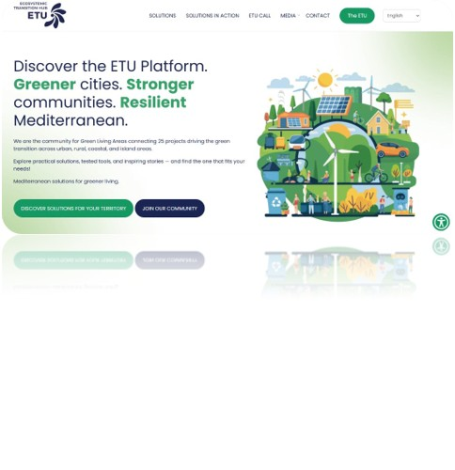
Next steps
ETU Platform: includes the catalogue of solutions. It gathers and classifies all TP’s results and solutions: they will be available in most Mediterranean languages, including Arabic, so Southern stakeholders can benefit from innovative solutions to design and implement their climate plans. Link to be shared.
Mentoring & Twinning with ETU call 2 (end of year 2026) and ETU call 3: a mentoring scheme will be developed to transfer TPs solutions to strategic takers; Southern municipalities will be informed and encouraged to apply to the open call.
Associated Partners in the South (from the TPs): strategic partners from the South (≈15) are involved in the production of results and outputs and the creation of synergies, and in translating results and outputs into Arabic and adapting them to the context.

Slide 9
Next steps
From 2026 (January – March): New series of Territorial Antennas ​focusing on TP solutions.
Feb 2026: launch of the ETU platform​
22 & 23 April 2026: Thematic Community annual event in Patras (max 3 people/TP)​
9-13 of June 2026: Festival of the New European Bauhaus in Brussels​
CIVITAS Forum Conference: presentation of the main solutions – Mobility.
End of November 2026: Mid-term event of the Interreg Euro-MED Programme

Slide 10
Next steps
Institutional Policy Dialogues in 2026 – a series of focused IPDs in the frame of existing targeted events:
May 2026, Athens: in the frame of the Circle the Med event (1 policy instrument related to energy communities, water communities and waste communities).
June 2026, Brussels: in the frame of the EU Sustainable Energy Week (1 policy instrument related to a Mediterranean energy transition policy framework).
September 2026, Paris: in the frame of the 6th Global Congress on Climate Change (1 policy instrument to be defined).

Slide 11
Next steps
Institutional Policy Dialogues in 2026 – a series of focused IPDs in the frame of existing targeted event:
12-13 November 2026, Patras: in the frame of a conference on mobility organised by UPatras (1 policy instrument related to mobility).
This Conference distinguishes itself by integrating resilience, connectivity, and sustainability into a single holistic framework that unites technological innovation (ITS and C-ITS), green mobility, and human-centered decision empowerment—linking technical, environmental, and policy dimensions across all transport modes.
In collaboration with Energy Cities Algeria, proposal to develop a specific Institutional Policy Dialogue for Algerian municipalities on the topic of energy communities.

Slide 13
Join our breakout room session!

Slide 14
Breakout room session – structure
Opening and framing – 5 minutes – Neus TIRADO / Florianne YVON (MedCities)
Short inputs from GP representatives – 15 minutes – Presentation of the platforms for solutions and policy instruments:
ETU Platform - 8 minutes – Magalí OUTTERS (EMEA)
EUCLID collaborative platform of policy-oriented solutions, notably available for stakeholders from the Southern shore of the Mediterranean - 7 minutes, Marina KOUTA (UPatras)
Dynamic discussion – 30 minutes – Francesco FILIPPI & Francesco MOLINARI (NUDGES TP), with the active participation of Streets for Citizens TP and CO2 Pacman TP from the audience.
Discussion around the achievements of the Nudges Thematic Project, at technical level and at policy level, which could be adapted / replicated in the southern territories of the Med Area (Integrating "nudging" (behavioral change) strategies into the urban climate change mitigation and adaptation MED policies)
Testimony from a Southern shore stakeholder – 5 minutes – Sid Ali HASNI (Energy Cities Algeria)
Proposal to develop a specific Institutional Policy Dialogue for Algerian municipalities on the topic of energy communities.
Wrap-up and key messages – 5 minutes – Bernard MASSABO (Nice Côte d’Azur Metropolis)

